Slide 1
Employee Data Analysis using Excel
STUDENT NAME: M. PAVITHRA
REGISTER NO: 312210035
DEPARTMENT: BCOM GENERAL
COLLEGE: VALLIAMMAL COLLEGE FOR WOMEN

Slide 2
PROJECT TITLE
Employee Performance Analysis using Excel

Slide 3


AGENDA
Problem Statement
Project Overview
End Users
Our Solution and Proposition
Dataset Description
Modelling Approach
Results and Discussion
Conclusion
3/21/2024 Annual Review

Slide 4

PROBLEM STATEMENT
• To conduct a comprehensive analysis of current employee ratings to identify key trends, uncover areas needing improvement in core problems includes inconsistent performance, potential impact etc., using Excel techniques.
Notes:
• To conduct a comprehensive analysis of current employee ratings to identify key trends, uncover areas needing improvement in core problems includes inconsistent performance, potential impact etc., using Excel techniques.

Slide 5

PROJECT OVERVIEW
Identifying strengths and areas for improvement to optimize workforce productivity and satisfaction using Excel techniques.
DEPARTMENTS COVERED:
Production
Sales
IT/IS
PERFORMANCE METRICS: Fully meets
REPORTS: Detailed performance reports for individuals
Notes:
Identifying strengths and areas for improvement to optimize workforce productivity and satisfaction using Excel techniques.
DEPARTMENTS COVERED:
Production
Sales
IT/IS
PERFORMANCE METEICS: Fully meets
REPORTS: Detailed performance reports for individuals

Slide 6

WHO ARE THE END USERS?
HR Managers: To assess overall employee performance trends, identify training needs and use case metrics for recruitment and retention strategies.
Department Heads: Use performance data to set goals.
Performance Analysts: Generate reports and recommendations for optimising the performance management process.
Notes:
HR Managers: To assess overall employee performance trends, identify training needs and use case metrics for recruitment and retention strategies.
Department Heads: Use performance data to set goals.
Performance Analysts: Generate reports and recommendations for optimising the performance management process.

Slide 7

OUR SOLUTION AND ITS VALUE PROPOSITION
Sorting- Arrange in the Ascending Order
Filtering- Filling, Adjusting columns
Conditional Formatting- Highest To Lowest
Pivot Chart- Summary Of Employee Performance
Formulas- Excel Formulas
Graphs- Final Report

Slide 8
Dataset Description
Business Units Covered:
TNS BPC WBL CCDR NEL SVG MSC EW PYZ PL
Employee ID: 3431 to 3450
Performance Scores:
Fully Meets: 14 Employees Exceeds: 6 Employees
Notes:
Business Units Covered:
TNS BPC WBL CCDR NEL SVG MSC EW PYZ PL
Employee ID: 3431 to 3450
Performance Scores:
Fully Meets: 14 Employees Exceeds: 6 Employees

Slide 9
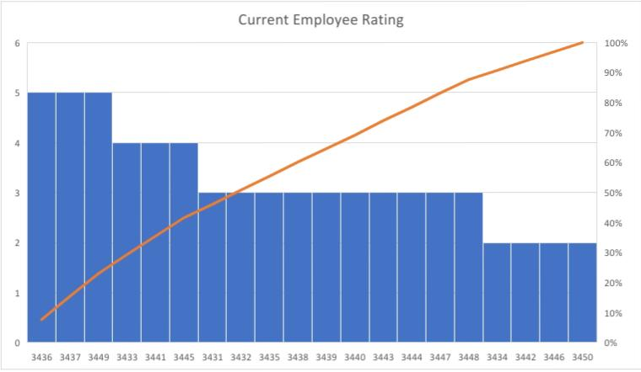

THE "WOW" IN OUR SOLUTION
The “WOW” in our solution is employees with high recognised performance rating.
3/21/2024 Annual Review
9
Notes:
The “WOW” in our solution is employees with high recognised performance rating.

Slide 10
MODELLING
Data Set: employee dataset
Feature selection: work location
Data Cleaning: missing value, irrelevant
Formula-performance calculation, low, medium, high, sum
Pivot table and chart: summary, business unit, gender, employee type, employee ID, performance.
Chart : Pie, Bar, Line, Pivot chart.
10

Slide 11
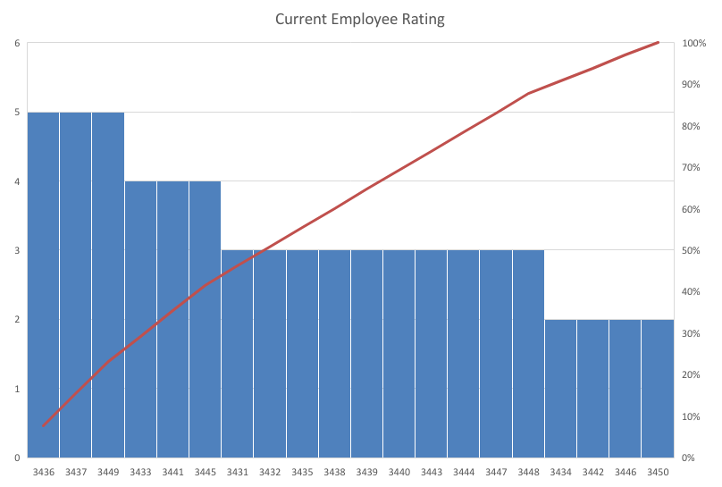
RESULTS
11

Slide 12
conclusion
• The data suggests a balanced performance distribution among the employees, with opportunities for further development and recognition. Continuous monitoring and targeted interventions can help improve overall employee performance and satisfaction.
Notes:
The data suggests a balanced performance distribution among the employees, with opportunities for further development and recognition. Continuous monitoring and targeted interventions can help improve overall employee performance and satisfaction.

